Slide 1
Operator Overloading-I
Said Nabi

Slide 2
Function Overloading
An overloaded function is one which has the same name but several different forms
For example:
We can overload the constructor for the Date class:
  default Date d;
  Parametrized (3 ints) Date d(9,22,20);
  copy Date d1(d);
  Parametrized (1 string, 2 ints) Date d(“Sept”,22,2020);

Slide 3
Operator Overloading
The method of defining additional meanings for operators is known as operator overloading
Enables an operator to perform different operations depending upon the type of operands
The basic operators i.e. +, -, *, / normally works with basic types i.e. double, float, int, long. (defined in C++)
So, how can these operators be applied to user-defined data types?

Slide 4
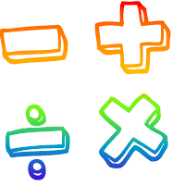
Operator Overloading
The operator “+” also has different semantics depending on the type of its “arguments”
Example
int i=5, j=7;
i + j; //add two int
double d=5.4, e=3.0;
i + d; //add an int and a double
d + e; //add two doubles

Slide 5
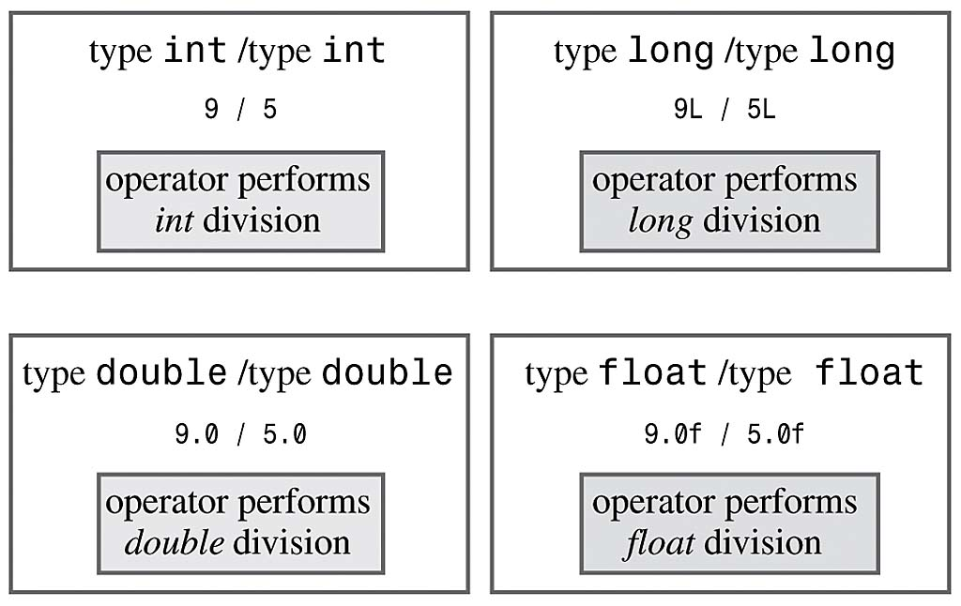
Operator Overloading
Example (already overloaded operator / ):
Same operator has different meaning for different operands

Slide 6
Operator Overloading Motivation
Don’t want to create new operators for user-defined data types
Conclusively, Operator overloading:
  Enabling C++’s operators to work with class objects
  Using traditional operators with user-defined objects
  Requires great care; when overloading is misused, program difficult to understand
  Examples of already overloaded operators:
    Operator << is both the stream-insertion operator and the bitwise left-shift operator

Slide 7
How to Overload an Operator?
An operator can be overloaded by declaring a special member function in the class
Name of the member function is operator that is followed by operator symbol e.g., operator+, operator/, etc.
Can be independent function (except for the following operators: ( ), [ ], -> or any of the assignment operators)
Can be a class’s member function (must be non-static)
Notes:
Can be a member function (must be non-static): to be able to work on objects of the class
If you plan on implementing ->, () or [] they are naturally member methods.
The binary operators = (assignment), [] (array subscription), -> (member access), as well as the n-ary () (function call) operator, must always be implemented as member functions, because the syntax of the language requires them to.

Slide 8
How to Overload an Operator?
Member function: If the left operand of that particular class is an object of the same class, then the overloaded operator is said to be implemented by a member function.
Non-member function: If the left operand of that particular class is an object of a different class, then the overloaded operator is said to be implemented by a non-member function
Notes:
A unary operator @, applied to an object x, is invoked either as operator@(x) [non member implementation] or as x.operator@() [member implementation].
A binary infix operator @, applied to the objects x and y, is called either as operator@(x,y) [non-member implementation] or as x.operator@(y) [member implementation]

Slide 9
Overload as Member or Non-Member Function
If it is a unary operator, implement it as a member function.
If a binary operator treats both operands equally (it leaves them unchanged), implement this operator as a non-member function.
If a binary operator does not treat both of its operands equally (usually it will change its left operand), it might be useful to make it a member function of its left operand’s type

Slide 10
Syntax to Overload an Operator
returnType operatoropsymbol(parameters) { }
↑ ↑ ↑ ↑
any type keyword operator symbol function body
Example:
void operator+ (parameters) { }
↑ ↑ ↑ ↑
any type keyword operator symbol function body
return-type may be whatever the operator returns
Operator symbol may be any over-loadable operator

Slide 11
Operator Overloading
Operators are really functions
  They have arguments, they return values
  The only difference is that their names take on a specific form:
  Operator+, operator[ ]
Overloading provides concise notation:
// without operator overloading
object2 = object1.add(object2);
// with operator overloading
object2 = object2 + object1;

Slide 12
Restriction on Operator Overloading
With operator overloading we cannot change:
  How operators act on built-in data types:
    i.e., cannot change integer addition
  Precedence of operator (order of evaluation)
    Use parentheses to force order-of-operations
  Association rules (left-to-right or right-to-left evaluation)
  Number of operands
    i.e., & is unary, only acts on one operand
  Cannot create new operators
  Operators must be overloaded explicitly:
  i.e., Overloading + , does not overload +=
Notes:
at least one of the operands has to be of a user-defined type.

Slide 13
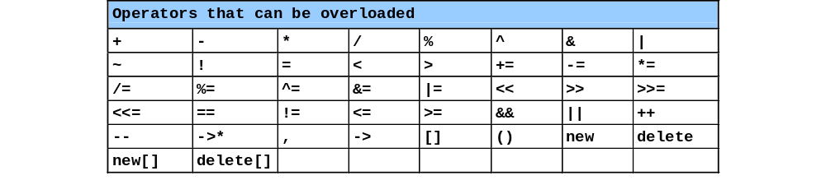
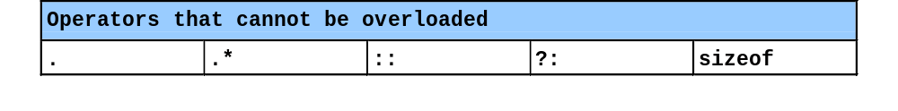
Restriction on Operator Overloading
Notes:
The comma operator (represented by the token, ) is a binary operator that evaluates its first operand and discards the result, it then evaluates the second operand and returns this value (and type). The comma operator has the lowest precedence of any C operator, and acts as a sequence point.
->* is an operator to operate on function pointers

Slide 14
Operator =, operator &
Operator = and operator & are overloaded implicitly for every class, so they can be used for each class objects.
operator = performs member-wise copy of the data members.
operator & returns the address of the object in memory.

Slide 15
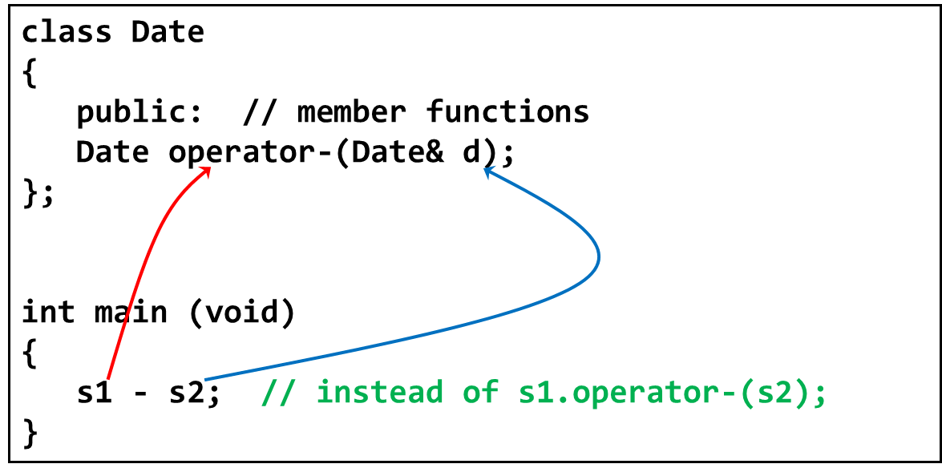
Invoking Objects
If the operator is binary but there is only one explicit argument, the calling object is assumed to be the left operand

Slide 16
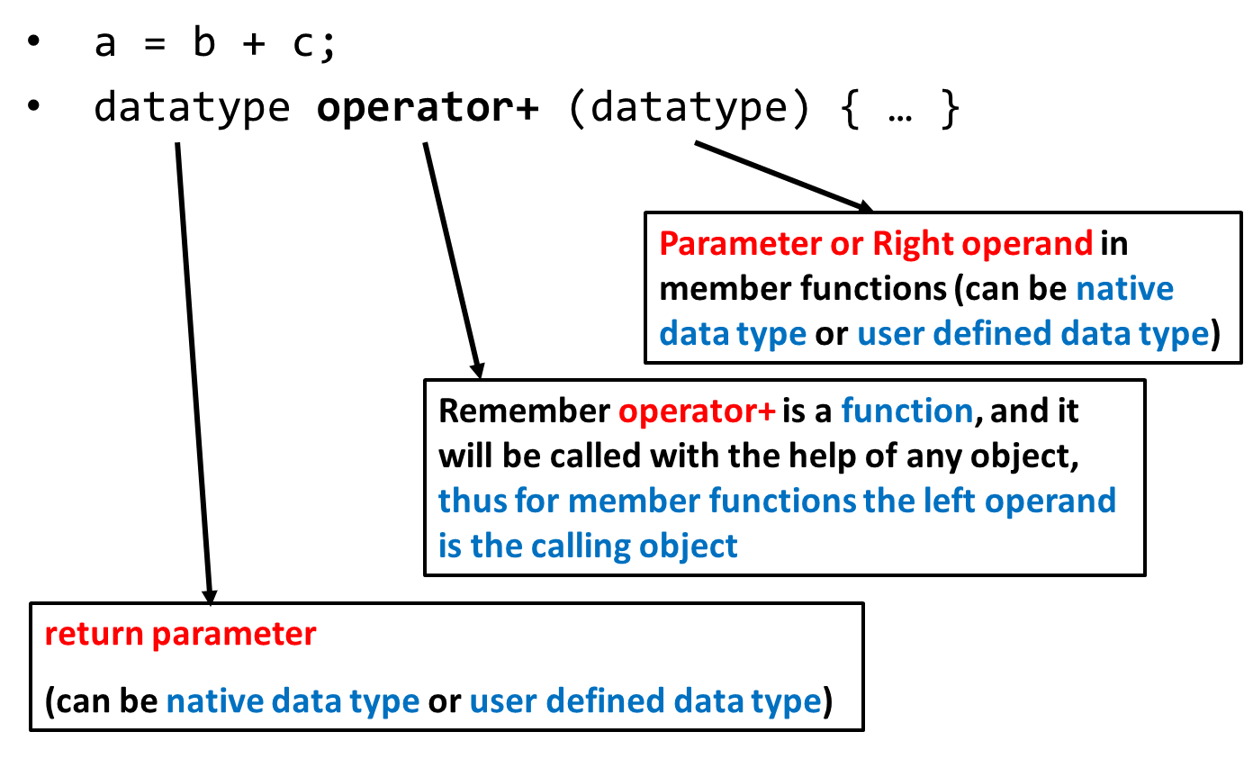
Operator Overloading Syntax

Slide 17
Operator Overloading Syntax
datatype operator+ (datatype)
Example (1): parameter of primitive data type
return value of primitive data type
  class myClass
  {
  int operator+ ( int );
  }
  int main ( )
  {
  int a,b=5;
  myClass object1;
  a = object1 + b;
  }

Slide 18
Operator Overloading Syntax
datatype operator+ (datatype)
Example (2): parameter of user defined data type
return value of primitive data type
  class myClass
  {
  int operator+ ( myClass &a );
  }
  int main ( )
  {
  int a;
  myClass object1, object2;
  a = object1 + object2;
  }

Slide 19
Operator Overloading Syntax
datatype operator+ (datatype)
Example (3): parameter of primitive data type
return value of user defined data type
  class myClass
  { myClass operator+ ( int ); }
  int main ( )
  {
  int a = 5;
  myClass object1, object2;
  object2 = object1 + a;
  }

Slide 20
Operator Overloading Syntax
datatype operator+ (datatype)
Example (4): parameter of user defined data type
return value of user defined data type
  class myClass
  {
  myClass operator+ ( myClass &a );
  }
  int main ( )
  {
  myClass object1, object2, object3;
  object3 = object1 + object2;
  }

Slide 21
Operator Overloading
Relational operators are also binary and can be overloaded in the same way
< , > , <= ,>= , ==
To add operator functionality in the class
First create a function for the class
Set the name of the function with the operator name
  operator+ for the addition operator ‘+’
  operator> for the comparison operator ‘>’

Slide 22
Overloading > operator
bool Employee::operator>(Employee& e)
{
return(seniority > e.getSeniority());
}
called from the program like this:
if (emp1 > emp2)

Slide 23
Implementing Overloaded Operators
The compiler uses the types of arguments to choose the appropriate overloading.
int v1, v2;
v1 + v2; // int +
float s1, s2;
s1 + s2; // float+

Slide 24
Extended Example
class Employee
{
  private:
  int idNum;
  double salary;
  public:
  Employee(int id, double salary);
  double addTwo (Employee& emp);
  double operator+ (Employee& emp);
  double getSalary() { return salary; }
};

Slide 25
The member functions ‘addTwo’ and operator+
//function notation
double Employee::addTwo(Employee& emp)
{
double total;
total = this->salary + emp.getSalary();
return total;
}
//operator overloading notation
double Employee::operator+(Employee& emp)
{
double total;
total = this->salary + emp.getSalary();
return total;
}

Slide 26
Using the Member Functions
double sum;
Employee Clerk (111, 10000), Driver (222, 6000);
// these three statements do the same thing
sum = Clerk.addTwo(Driver);
sum = Clerk.operator+(Driver);
sum = Clerk + Driver;
// the syntax for the last one is the most natural
// and is easy to remember because it is consistent
// with how the + operator works for everything else

Slide 27
Multiple Operators
Often, you may need to reference an operator more than once in an expression:
Example:
  total = a + b + c;
But this can cause problems when operator overloading is involved
See next example…

Slide 28
Client Code for Class Employee
void main()
{
Employee Clerk(115, 20000.00);
Employee Driver(256, 15500.55);
Employee Secretary(567, 34200.00);
double sum;
sum = Clerk + Driver + Secretary;
cout << “Sum is “ << sum;
}

Slide 29
The Problem
Operator + is left to right associative, so Clerk and Driver are added. The result is a double.
double + Secretary; //ERROR
The overloaded operator+ function is a member of the employee class.
Left operand MUST be an object of Employee class.

Slide 30
The Problem Gets Worse
A member function CANNOT overload an operator like this:
  Primitive data type + User-defined data type //ERROR
  double + Employee
  sum = num + Secretary; // why not?
Whenever an operator is overloaded as a member function. The left operand must be of that SAME class.
Here the left operand is a double, we cannot create an overloaded function in the double class
There are two ways to make this work for
member function
non-member function

Slide 31
Solution 1
sum = Clerk + Driver + Secretary;
Make sure that your operator+ function never returns a double (or any other primitive type).
An operator to add Employees should return an Employee object.
Good practice that all your arithmetic binary operators
(+ - * / %) when overloaded should return an object

Slide 32
Solution 1
Employee class and objects
class Employee
{
  private:
  int idNum;
  double salary;
  public:
  Employee(int id, double salary);
  Employee operator+ (Employee& emp);
  double getSalary() { return salary; }
}

Slide 33
Solution 1
Employee Employee::operator+(Employee& emp)
{
double sal = salary + emp.salary;
Employee total(0, sal);
return total; //returns an object
}
void main()
{
Employee Clerk(115, 20000.00);
Employee Driver(256, 15500.55);
Employee Secretary(567, 34200.00);
Employee sum(0, 0.0);
sum = Clerk + Driver + Secretary;
}

Slide 34
Solution 2
sum = Clerk + Driver + Secretary;
Make a non-member operator+ function that returns an Employee object.

Slide 35
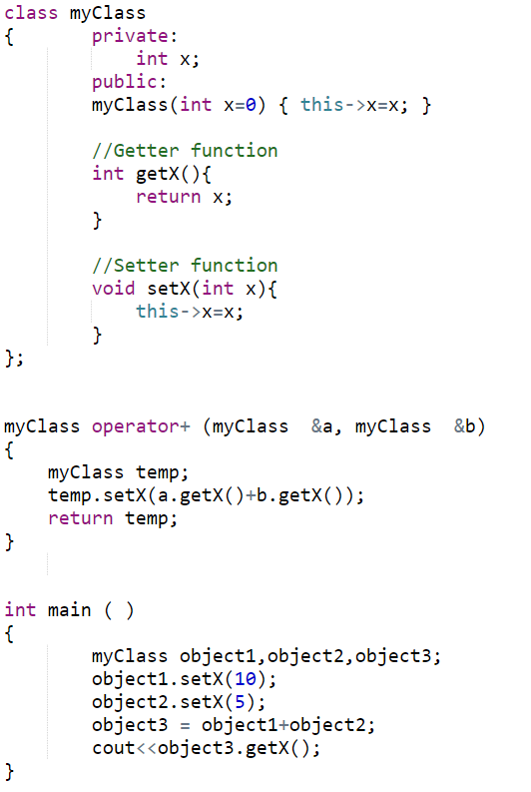

Slide 36
Assignment Operator =
Operator = is overloaded implicitly for every class, so they can be used for each class objects.
Recall default copy constructor
operator = performs member-wise copy of the data members.
However, there is a problem with implicitly overloaded operator=
Recall shallow copy

Slide 37
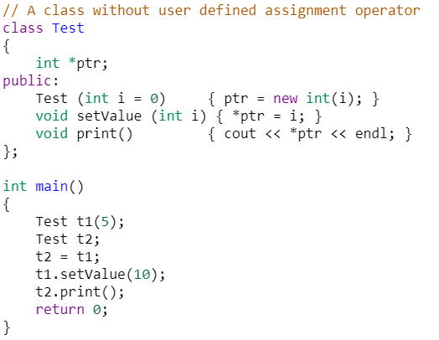
Using implicit Overloaded Assignment Operator
Output = 10

Slide 38
Assignment Operator =
class Employee
{ private:
  int idNum;
  double salary;
  public:
  Employee ( ) { idNum = 0, salary = 0.0; }
  void setValues (int a, int b);
  void operator= (double); //prototype
}
void Employee::setValues ( int idN , double sal )
{
salary = sal; idNum = idN;
}
void Employee::operator= (double sal)
{ salary = sal; }
Assignment operator can ONLY be overloaded as a member function

Slide 39
Assignment Operator =
int main ( )
{
Employee emp1;
emp1.setValues(10,33.5);
Employee emp2;
emp2 = 44.6; // emp2 is calling object
}
Overloaded as a member function so left operand must be an object of the same class
Right operand a double (parameter of the overloaded = function)

Slide 40
Assignment Operator =
class Employee
{ private:
  int idNum;
  double salary;
  public:
  Employee ( ) { idNum = 0, salary = 0.0; }
  void setValues (int a, int b);
  double getSalary() { return salary }
  void operator= (Employee &emp );
}
void Employee::setValues ( int idN , double sal )
{ salary = sal; idNum = idN; }
void Employee::operator = (Employee &emp)
{ salary = emp.getSalary(); }

Slide 41
Assignment Operator =
int main ( )
{
Employee emp1;
emp1.setValues(10,33.5);
Employee emp2;
emp2 = emp1; // emp2 is calling object
}

Slide 42
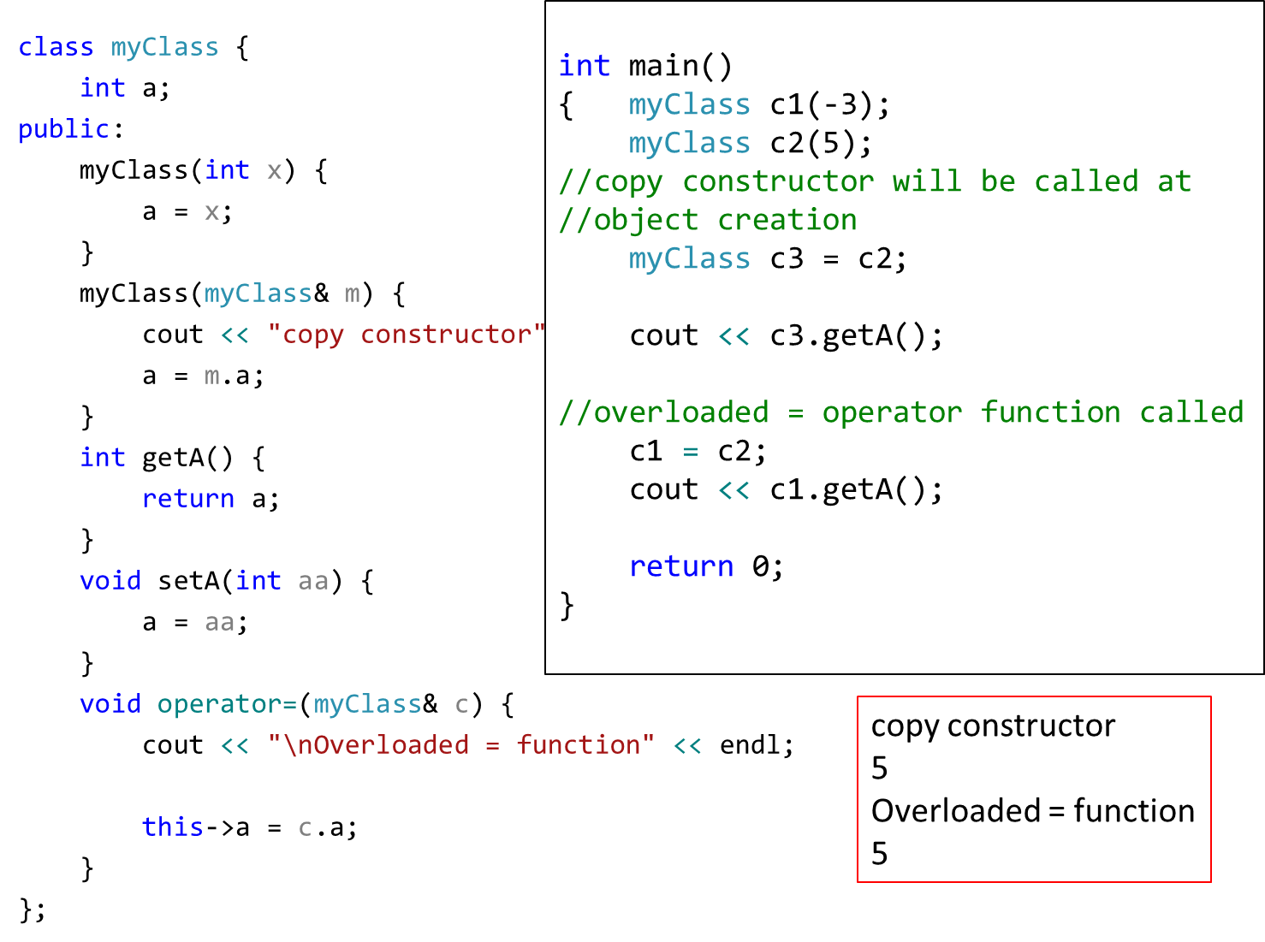

Slide 43
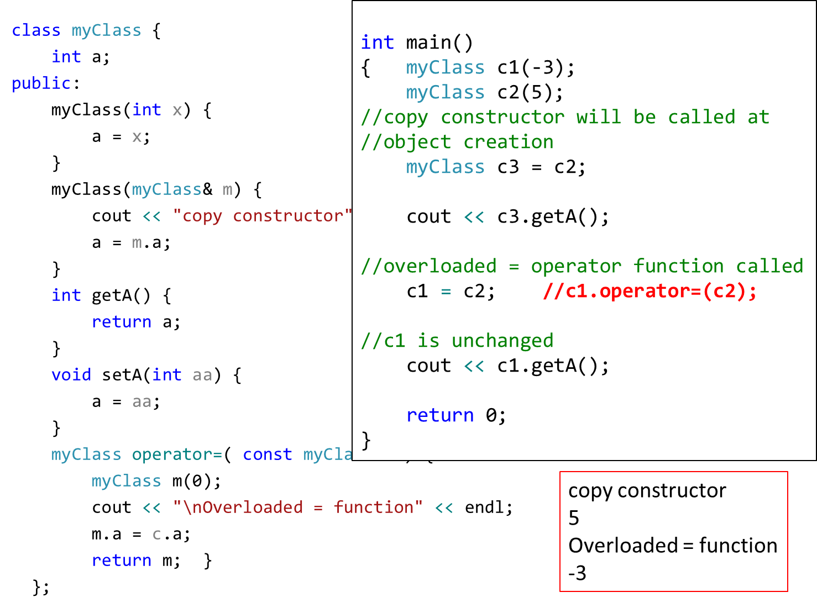

Slide 44
Comparison Operator ==
class Employee
{ private:
  int idNum;
  double salary;
  public:
  Employee ( ) { idNum = 0, salary = 0.0; }
  void setValues (int a, int b);
  double getSalary() { return salary }
  bool operator== ( Employee &emp );
}
void Employee::setValues ( int idN , double sal )
{ salary = sal; idNum = idN; }
bool Employee::operator == (Employee &emp)
{ return (salary == emp.getSalary()); }

Slide 45
Comparison Operator ==
class Employee
{ private:
  int idNum;
  double salary;
  public:
  Employee ( ) { idNum = 0, salary = 0.0; }
  void setValues (int a, int b);
  double getSalary() { return salary }
  }

Slide 46
Comparison Operator ==
int main ( )
{
Employee emp1;
emp1.setValues(10,33.5);
Employee emp2;
emp2.setValues(10,33.1);
if ( emp2 == emp1 )
cout <<“Both objects have equal value”;
else
cout <<“objects do not have equal value”;
}

Slide 47
Operator Overloading Syntax
Syntax of an overloaded operator function:
  datatype operator+ (datatype)
However, for some operators, this syntax will be slightly different:
  ++, -- operators
  >>, << operators
  & and [ ] operators

Slide 48
Overloading ++ and - -
Operator ++ and -- are different to other operators of C++
We can call them:
  either in the form of prefix (++i) before an object
  or in the form of postfix (i++) after an object
  But in both cases, the calling object will be i.

Slide 49
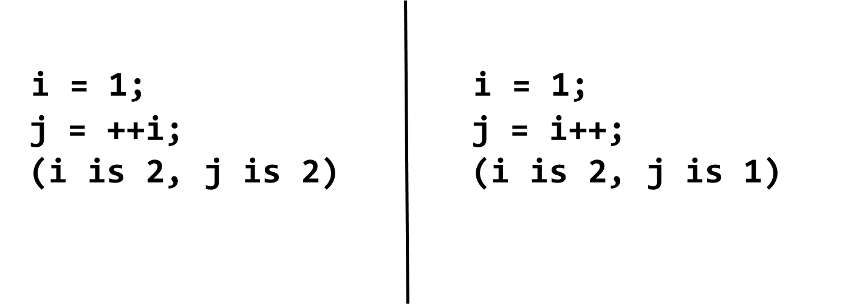
i++ and ++i ?
Prefix makes the change, and then processes the variable
Postfix processes the variable, then makes the change.

Slide 50
Overloaded ++
class Inventory
{
private:
int stockNum;
int numSold;
public:
Inventory(int stknum, int sold);
void operator++();
};
void Inventory::operator++()
{
numSold++;
}

Slide 51
Use of the operator ++
int main ( )
{
Inventory someItem(789, 84);
// the stockNum is 789
// the numSold is 84
++someItem;
Inventory Item2 = ++someItem;
//will this instruction work
// Will not work as the overloaded function does not return anything
}

Slide 52
Overloaded ++
class Inventory{
private:
int stockNum;
int numSold;
public:
Inventory(int stknum, int sold);
Inventory& operator++();
};
Inventory& Inventory::operator++(){
Inventory *object = new Inventory(0,0);
numSold++;
object->numSold = numSold;
return(*object);
}

Slide 53
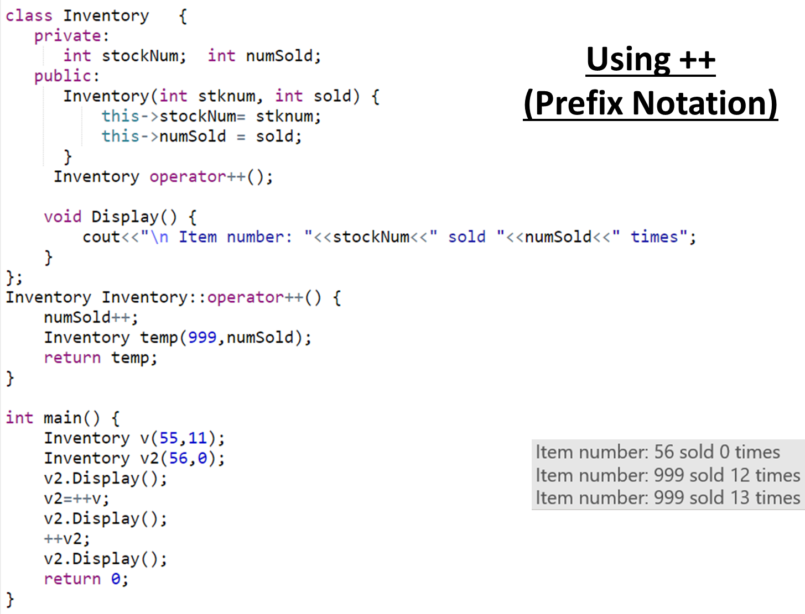

Slide 54
Problem
The definition of the prefix operator is simple. It increments the value before any other operation.
But, how will C++ be able to tell the difference between a prefix ++ operator and a postfix ++ operator?
Answer: overloaded postfix operator will take a dummy argument (just for differentiation between postfix and prefix).

Slide 55
Postfix operator
Inventory& Inventory::operator++() // prefix version
{
Inventory *object = new Inventory(0,0);
numSold++;
object->numSold = numSold;
return(*object);
}
Inventory& Inventory::operator++(int) // postfix version
{
Inventory *object = new Inventory(0,0);
object->numSold = numSold;
numSold++;
return(*object);
}

Slide 56
